Slide 1

MODULE-2 Supervised Learning

Slide 2
SUPERVISED LEARNING
In supervised learning, the labelled training data provide the basis for learning.
The process of learning from the training data by a machine can be related to an expert supervising the learning process of a student.
Here the expert is the training data.
Training data is the past information with known value of class field or ‘label’.
Unsupervised learning uses no labelled data.
Semi-supervised learning uses a small amount of labelled data.

Slide 3
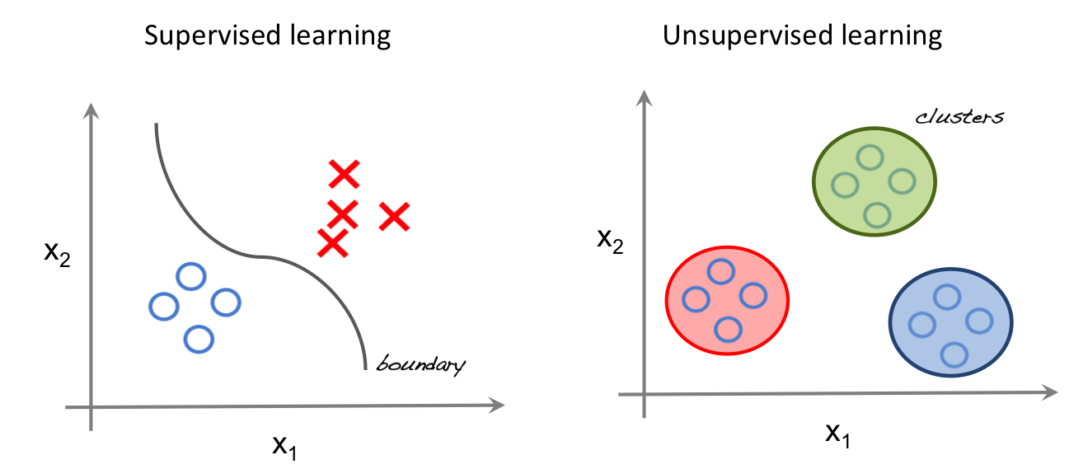
Supervised vs Unsupervised

Slide 4
Classification Model
When we try to predict a categorical or nominal variable, the problem is known as a classification problem.
Here, the problem centres around assigning a label or category or class to the test data on the basis of the label or category or class information imparted by training data.
Classification is a type of supervised learning where a target feature, i.e. A categorical type, is predicted for test data on the basis of information obtained from training data.
This categorical feature is known as class.

Slide 5
Classification Learning Steps
Problem
Identification of required data
Data Pre Processing
Definition of Training set
Algorithm Selection
Parameter Training
Training
Evaluation with Test Set
YES
OK
Classifier

Slide 6
Common Classification Algorithms
k-Nearest Neighbour (kNN)
Decision tree
Random forest
Support Vector Machine (SVM)
Naive Bayes classifier

Slide 7
ORIGINS OF K-NN
Nearest Neighbors have been used in statistical estimation and pattern recognition already in the beginning of 1970’s (non- parametric techniques).
The method prevailed in several disciplines and still it is one
of the top 10 Data Mining algorithm.

Slide 8
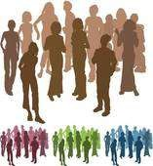
IN A SENTENCE K-NN IS…..
It’s how people judge by observing our peers.
We tend to move with people of similar attributes so does data.

Slide 9
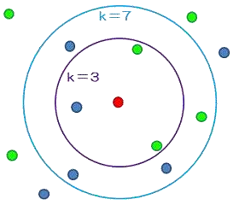
DEFINITION
K-Nearest Neighbor is considered a lazy learning algorithm that classifies data sets based on their similarity with neighbors.
“K” stands for number of data set items that are considered for the classification.
Ex: Image shows classification for
different k-values.

Slide 10
TECHNICALLY..
For the given attributes A={X₁, X₂….. X_{D}} Where D is the dimension of the data, we need to predict the corresponding classification group G={Y₁,Y₂…Y_{n}} using the proximity metric over K items in D dimension that defines the closeness of association such that X € R^{D} and Y_{p} € G.

Slide 11


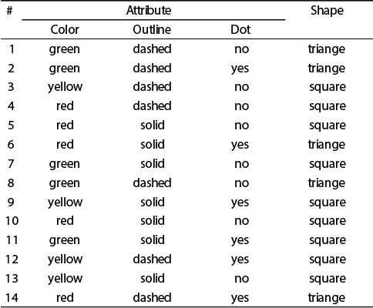
Attributes A
THAT IS..
Attribute A={Color, Outline, Dot}
Classification Group, G={triangle, square}
D=3, we are free to choose K value.
C
l a s s i f i c a t i o n
G
r o u p

Slide 12
PROXIMITY METRIC
Definition: Also termed as “Similarity Measure” quantifies the association among different items.
Following is a table of measures for different data items:
Similarity Measure | Data Format
Contingency Table, Jaccard coefficient, Distance Measure | Binary
Z-Score, Min-Max Normalization, Distance Measures | Numeric
Cosine Similarity, Dot Product | Vectors

Slide 13
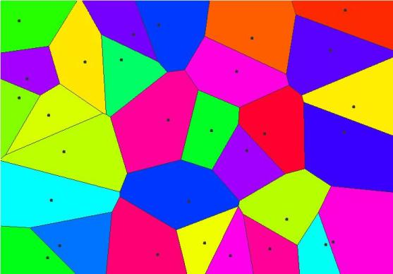
Voronoi diagram
A Voronoi diagram is a partitioning of a plane into regions based on distance to points in a specific subset of the plane.
Here, k=1.

Slide 14
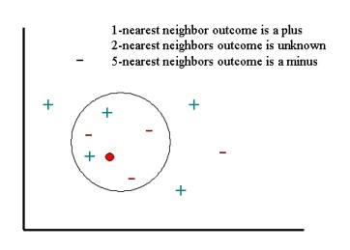
K-NN Example

Slide 15
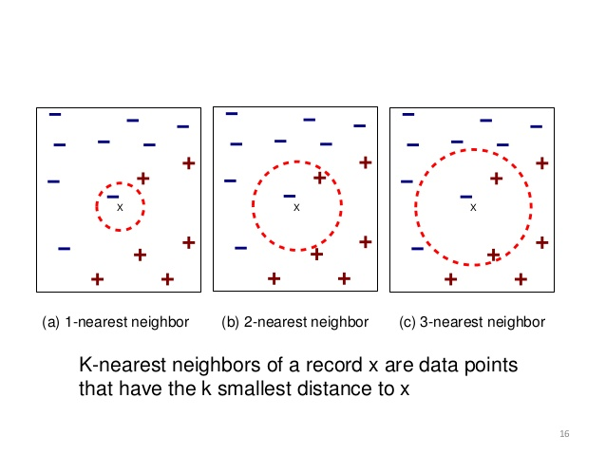
K-NN Example

Slide 16


PROXIMITY METRIC
For the numeric data let us consider some distance measures:
– Manhattan Distance:
– Ex: Given X = {1,2} & Y = {2,5}
Manhattan Distance = dist(X,Y) = |1-2|+|2-5|
= 1+3
= 4

Slide 17

PROXIMITY METRIC
- Euclidean Distance:
- Ex: Given X = {-2,2} & Y = {2,5}
Euclidean Distance = dist(X,Y) = [ (-2-2)^2 + (2-5)^2]^(1/2)
= dist(X,Y) = (16 + 9)^(1/2)
= dist(X,Y) = 5

Slide 18

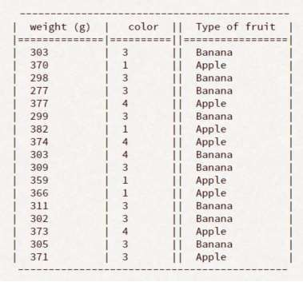
K-NN IN ACTION
Consider the following data: A={weight,color} G={Apple(A), Banana(B)}
We need to predict the type of a
fruit with: weight = 378 color = red

Slide 19

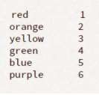
SOME PROCESSING..
Assign color codes to convert into numerical data:
Let’s label Apple as “A” and Banana as “B”

Slide 20

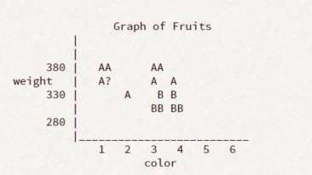

PLOTTING
Using K=3,
Our result will be,

Slide 21

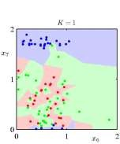
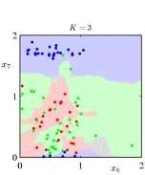
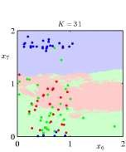
AS 'K' VARIES….
Clearly, K has an impact on the classification.
Can you guess?

Slide 22
K-NN PROPERTIES
K-NN is a lazy algorithm
The processing defers with respect to K value.
Result is generated after analysis of stored data.
It neglects any intermediate values.

Slide 23
REMARKS: FIRST THE GOOD
Advantages
Can be applied to the data from any distribution,
for example, data does not have to be separable with a linear boundary
Very simple and intuitive
Good classification if the number of samples is large enough

Slide 24
NOW THE BAD….
Disadvantages
Dependent on K Value
Test stage is computationally expensive
No training stage, all the work is done during the test stage
This is actually the opposite of what we want. Usually we can afford training step to take a long time, but we want fast test step.
Need large number of samples for accuracy

Slide 25
DECISION TREE

Slide 26
This is one of the most adopted algorithms for classification.
It builds a model in the form of a tree structure.
A decision tree is used for multi-dimensional analysis with multiple classes and is characterized by ease of interpretation of rules and fast execution.
The goal of decision tree learning is to create a model that predicts the value of the output variable based on the input variables in the feature vector.
It contains a decision node and a leaf node.
Each decision node corresponds to one of the feature vector.

Slide 27
From every node, there are edges to children, wherein there is an edge for each of the possible values of the feature associated with the node.
The output variable is determined by following a path that starts at the root and is guided by the values of the input variables.
Decision trees can be used for both classification and regression.

Slide 28
Decision Tree for PlayTennis
Outlook
Sunny
Overcast
Rain
Humidity
Each internal node tests an attribute
High
Normal
Each branch corresponds to an
attribute value node
No
Yes
Each leaf node assigns a classification

Slide 29
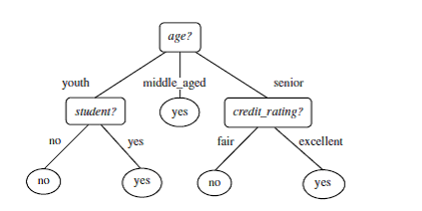
Example-1
Will a person buy a computer?

Slide 30
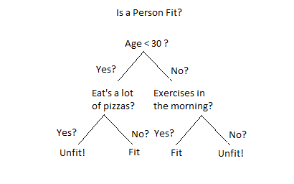
Example-2
Is a person fit?

Slide 31
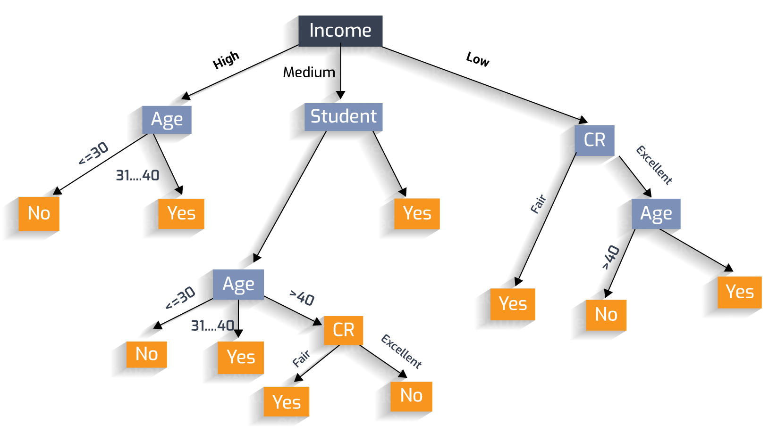
Example-3
Should the LOAN be sanctioned?

Slide 32
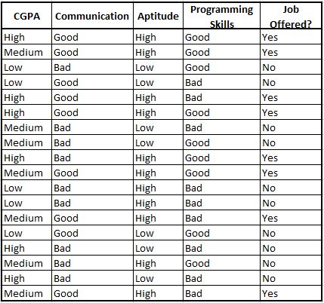
Training Data for GTS recruitment

Slide 33
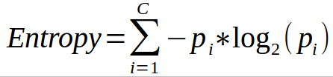
Entropy of a decision tree
Entropy, as it relates to machine learning, is a measure of the randomness in the information being processed.
The higher the entropy, the harder it is to draw any conclusions from that information.
Ex: For class ‘Job Offered?’ we have two values: Yes and No.
Pi values for Yes= 8/18 = 0.44 & No= 10/18= 0.56
Entropy(S) = -0.44 log2(0.44) – 0.56 log2(0.56)
= 0.99

Slide 34
Information gain of a decision tree
The information gain is created on the basis of the decrease in entropy(S) after a data set is split according to a particular attribute(A).
Constructing a decision tree is all about finding an attribute that returns the highest information gain.
If information gain is 0, it means that there is no reduction in entropy due to split of the data set according to that particular feature.
The maximum amount of information gain which may happen is the entropy of the data set before the split.

Slide 35
Information gain for a particular feature A is calculated by the difference in entropy before a split(Sbs) with the entropy after the split(Sas).
Information gain(S, A) = Entropy(Sbs) – Entropy(Sas)
For weighted summation, the proportion of examples falling into each partition is used as weight.
Entropy(Sas) = ∑ (i=1 to n) wi Entropy(pi)

Slide 36
Total Entropy = 0.99
a) Original data set
 | Yes | No | Total
Count | 8 | 10 | 18
pi | 0.44 | 0.56
-pi*LOG(pi) | 0.52 | 0.47 | 0.99
b) Splitted data set(based on the CGPA)
CGPA = High |  |  |  |  | CGPA = Medium |  |  |  |  | CGPA = Low
 | Yes | No | Total |  |  | Yes | No | Total |  |  | Yes | No | Total
Count | 4 | 2 | 6 |  | Count | 4 | 3 | 7 |  | Count | 0 | 5 | 5
pi | 0.67 | 0.33 |  |  | pi | 0.57 | 0.43 |  |  | pi | 0 | 1
-pi*LOG(pi) | 0.39 | 0.53 | 0.92 |  | -pi*LOG(pi) | 0.46 | 0.52 | 0.99 |  | -pi*LOG(pi) | 0 | 0 | 0
Total Entropy = (6/18*0.92 + 7/18*0.99 + 5/18*0) Information Gain
= 0.69 = 0.99-0.69 = 0.30

Slide 37
c) Splitted data set(based on ‘Communication’)
Communication = ‘Good’ Communication = ‘Bad’
Total Entropy = 0.63 Information Gain = 0.36
d) Splitted data set(based on ‘Aptitude’)
Aptitude = ‘High’ Aptitude = ‘Low’
Total Entropy = 0.52 Information Gain = 0.47(Entropy=0)
e) Splitted data set(based on ‘Programming Skills’)
Programming Skills = ‘Good’ Programming Skills = ‘Bad’
Total Entropy = 0.95 Information Gain = 0.04

Slide 38
Avoiding overfitting in decision tree- pruning
The decision tree algorithm, unless a stopping criterion is applied, may keep growing indefinitely.
To prevent a decision tree getting overfitted to the training data, pruning of the decision tree is essential.
Pruning a decision tree reduces the size of the tree such that the model is more generalized and can classify unknown and unlabeled data in a better way.
Pre-pruning: Stop growing the tree before it reaches perfection.
Post-pruning: Allow the tree to grow entirely and then post-prune some of the branches from it.

Slide 39
Random Forest Model
It is an ensemble classifier, i.e., a combining classifier that uses and combines many decision tree classifiers.
Ensembling is usually done using the concept of bagging with different feature sets.
The reason for using large number of trees in random forest is to train the trees enough such that contribution from each feature comes in a number of models.
After the random forest is generated by combining the trees, majority vote is applied to combine the output of the different trees.
Ensembled model yields better result than decision trees.

Slide 40


Slide 41
Random forest algorithm
The algorithm works as follows:
If there are N variables or features in the input data set, select a subset of ‘m’ (m<N) features at random out of the N features.
Use the best split principle on these ‘m’ features to calculate the number of nodes ‘d’.
Keep splitting the nodes to child nodes till the tree is grown to maximum possible extent.
Select a different subset of the training data ‘with replacement’ to train another DT with steps (1) to (3). Repeat this to build and train ‘n’ decision trees.
Final class assignment is done on the basis of the majority votes from the ‘n’ trees.

Slide 42
Strengths of RF
It runs efficiently on large and expensive data sets.
It has a robust method for estimating missing data and maintains precision when a large proportion of data is absent.
It has powerful techniques for balancing errors in a class population of unbalanced data sets.
It gives estimates about which features are the most important ones in the overall classification.

Slide 43
Drawback of RF
As it combines many decision trees, it is not easy to understand as a decision tree model.
Computationally, it is much more expensive than a simple decision tree.

Slide 44
Support Vector Machine
SVM is a model which can perform linear classification as well as regression.
It is based on the concept of a surface called hyperplane, which draws a boundary between data instances plotted on a multi-dimensional feature space.
The output prediction is one of the two classes defined in the training data.

Slide 45
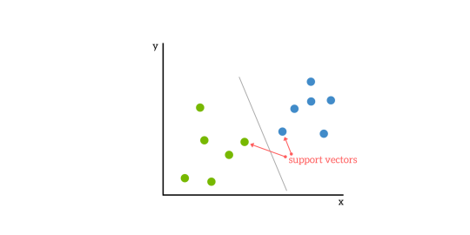

Slide 46
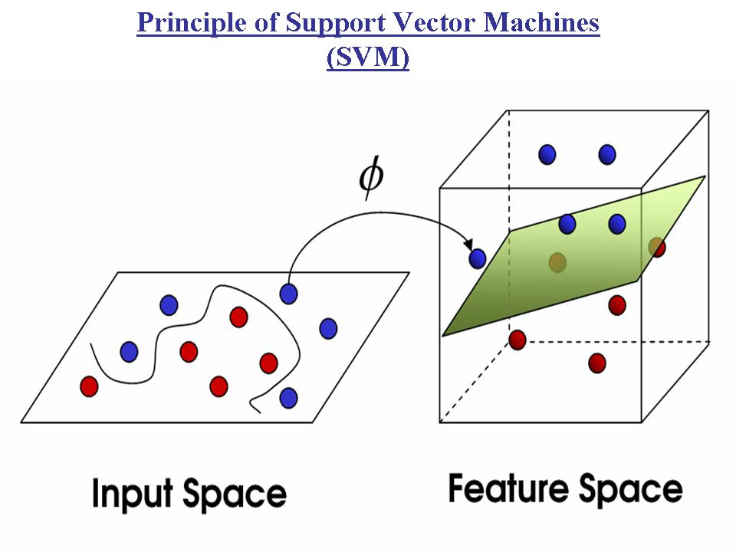

Slide 47
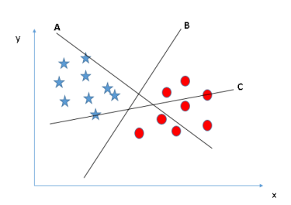
Identify the right hyper-plane (Scenario-1)
Here, we have three hyper-planes (A, B and C). Now, identify the right hyper-plane to classify star and circle.
Select the hyper-plane which segregates the two classes better?
In this scenario, hyper-plane “B” has excellently performed this job

Slide 48
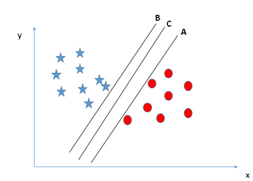
Identify the right hyper-plane (Scenario-2)
Here, we have three hyper-planes (A, B and C) and all are segregating the classes well. Now, How can we identify the right hyper-plane?
Here, maximizing the distances between nearest data point (either class) and hyper-plane will help us to decide the right hyper-plane. This distance is called as Margin.

Slide 49
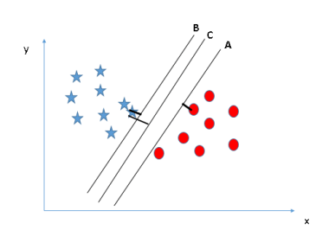
We can see that the margin for hyper-plane C is high as compared to both A and B. Hence, we name the right hyper-plane as C.

Slide 50
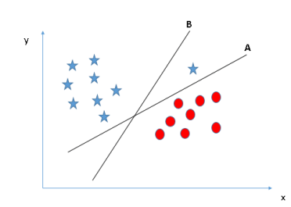
Scenario-3
Here hyper-plane B as it has higher margin compared to A.
SVM selects the hyper-plane which classifies the classes accurately prior to maximizing margin.
Hyper-plane B has a classification error and A has classified all correctly. Therefore, the right hyper-plane is A.

Slide 51
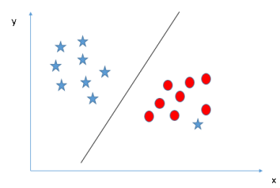
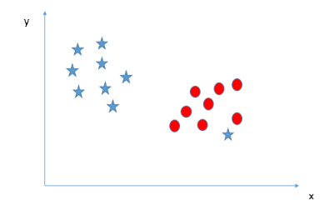
Scenario-4
Here, we are unable to segregate the two classes using a straight line, as one of star lies in the territory of other(circle) class as an outlier.
SVM has a feature to ignore outliers and find the hyper-plane that has maximum margin. SVM is robust to outliers.

Slide 52
Strengths of SVM
SVM can be used for both classification & regression.
It is robust, i.e. not much impacted by data with noise or outliers.
The prediction results using this model are very strong.

Slide 53
Weakness of SVM
SVM is applicable only for binary classification, i.e. when there are only two classes in the problem.
While dealing with high dimensional data, it becomes very complex.
It is slow for large dataset, i.e. a data set with more features or instances.
It is memory-intensive(throughput is bounded by the device memory bandwidth).

Slide 54
Introduction to Regression
Regression is a technique used to model and analyze the relationships between variables and often times how they contribute and are related to producing a particular outcome together.
Here, dependent variable (Y) is the one whose value is to be predicted, ex.- the price quote of the real estate property.
This variable is presumed to be functionally related to one (X) or more independent variables called predictors.
Y = f(X)

Slide 55
Common Regression Algorithms
The common regression algorithms are:
Simple linear regression
Multiple linear regression
Polynomial regression
Multivariate adaptive regression splines
Logistic regression
Maximum likelihood estimation(least square)

Slide 56
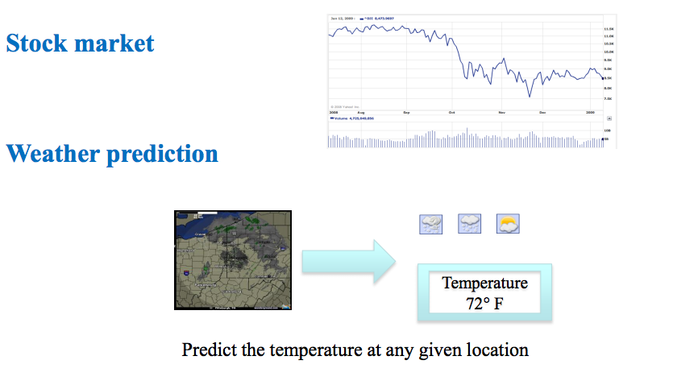
Regression examples

Slide 57
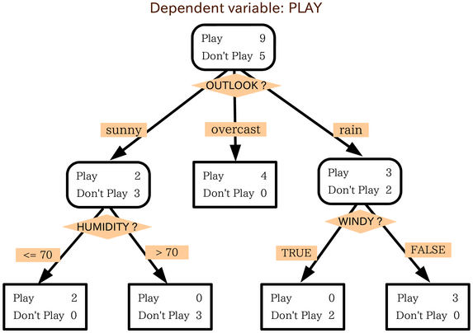
A decision tree: classification
Play
Don’t Play
Don’t Play
Play

Slide 58
A regression tree
Play ~= 37
Play ~= 5
Play ~= 0
Play ~= 32
Play = 30m, 45min
Play = 0m, 0m, 15m
Play = 0m, 0m
Play = 20m, 30m, 45m,

Slide 59
Linear regression
Given an input x we would like to compute an output y
For example:
- Predict height from age
- Predict Google’s price from Yahoo’s price
- Predict distance from wall from sensors
Y
X

Slide 60
Linear regression
Given an input x we would like to compute an output y
In linear regression we assume that y and x are related with the following equation:
y = wx+ε
where w is a parameter and ε represents measurement noise, model noise or other (data) noise
Y
What we are trying to predict
Observed values
X

Slide 62
Linear regression
Our goal is to estimate w from a training data of <x_{i},y_{i}> pairs
Optimization goal: minimize squared error (least squares):
Why least squares?
- minimizes squared distance between measurements and predicted line
- has a nice probabilistic interpretation (Gaussian Likelihood same as Mean Sq.)
- first degree polynomial model
Y
X

Slide 63
Multivariate regression
What if we have several inputs?
- Stock prices for Yahoo, Microsoft and Ebay for the Google prediction task
This becomes a multivariate regression problem
Again, its easy to model:
y = w₀ + w₁x₁+ … + w_{k}x_{k} + ε
Microsoft’s stock price
Google’s stock price
Yahoo’s stock price

Slide 64
Price of property = f ( Area, location, floor, ageing, amenities)
Y = a + b1 X1 + b2 X2
Where Y is the three-dimensional space, X1 & X2 are the predictor variables, b1 & b2 are referred as partial regression coefficients.

Slide 65
Assumptions in Regression Analysis
The dependent variable(Y) can be calculated as a linear function of a specific set of independent variables(X) and an error term(ϵ).
The number of observations(n) is greater than the number of parameters(k) to be estimated, ie n>k.
Regression line can be valid only over a limited range of data.
Variance is the same for all values of X.
The error term(ϵ) is normally distributed.
The values of the error term(ϵ) are independent and are not related to any values of X.
The OLS(Ordinary least square) estimator is the Best Linear Unbiased Estimator(BLUE) and this is called as Gauss-Markov Theorem.

Slide 66
Polynomial regression
Polynomial regression model is the extension of the simple linear model by adding extra predictors obtained by raising(squaring) each of the original predictors to a power.
If there are three variable, X, X², X³ are used as predictors.
F(x) = C₀ + C₁ X¹ + C₂ X² + C₃ X³

Slide 68
Let us use the below data set of (X, Y) for degree 3 polynomial
The regression line is slightly curved for degree = 3.
The regression line will curve further if we increase the polynomial degree.
Internal Exam(X) | 15 | 23 | 18 | 23 | 24 | 22 | 22 | 19 | 19 | 16 | 24 | 11 | 24 | 16 | 23
External Exam(X) | 49 | 63 | 58 | 60 | 58 | 61 | 60 | 63 | 60 | 52 | 62 | 30 | 59 | 49 | 68

Slide 69
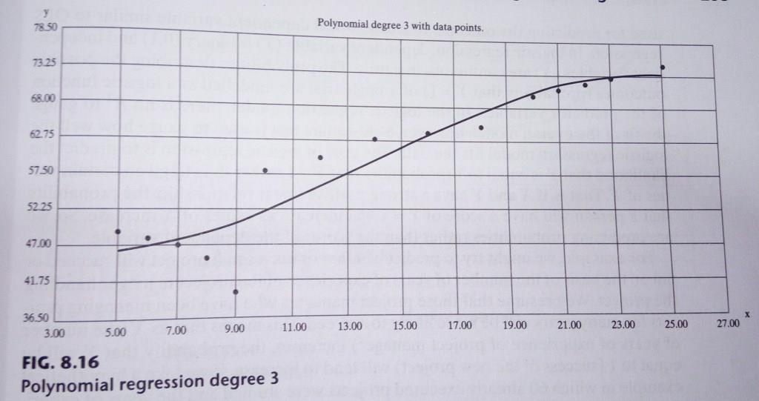

Slide 70
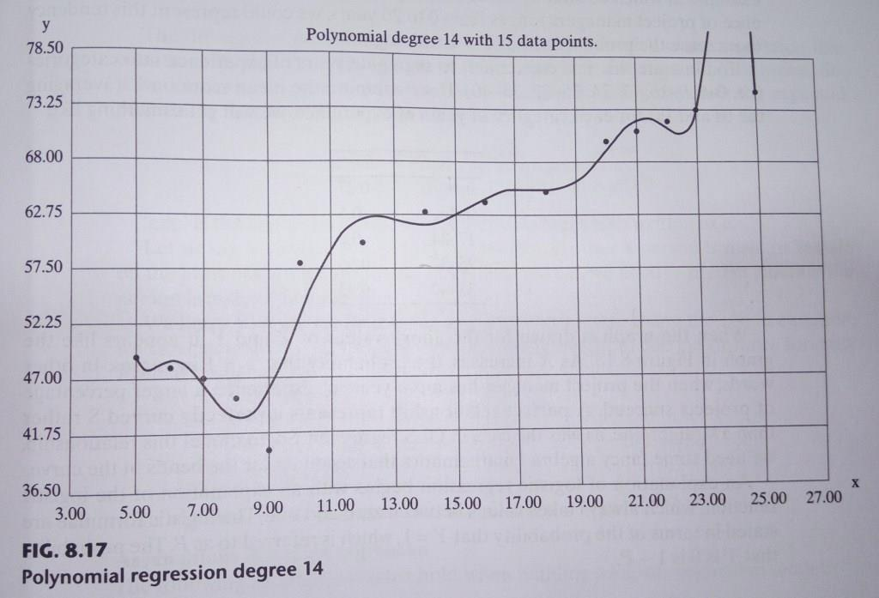

Slide 71
Logistic Regression
The logistic model is used to model the probability of a certain class or event existing such as pass/fail, win/lose, alive/dead or healthy/sick.
Logistic regression(LR) is a statistical model that in its basic form uses a logistic function to model a binary dependent variable.
It can be used for both Classification and Regression based on the given problem.
The goal of LR is to predict the likelihood that Y is equal to 1(probability that Y = 1 rather than 0) given certain values of X.

Slide 72
Example
We may predict the success or failure of a small project on the basis of the number of years of experience of the project manager handling the project.
This means that as X(the number of years of experience of manager) increases, the probability that Y will be equal to 1(success of project) will tend to increase.

Slide 73
Years of Experience | Probability of Success
0-8 | 0.27
9-16 | 0.5
17-24 | 0.6
25-32 | 0.66
33-40 | 0.93

Slide 74
END OF MODULE-2

